Slide 1
A Data science Project on
Customer Retentation
Submitted by: Santosh Arvind Dharam

Slide 2
Problem Statement
E-retail factors for customer activation and retention: A case study from Indian e-commerce customers
Data Scientists have to apply their analytical skills to give findings and conclusions in detailed data analysis

Slide 3
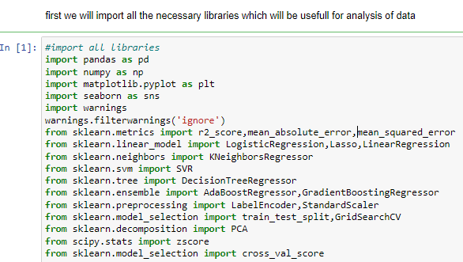
EDA steps step-1(import necessary libraries)

Slide 4
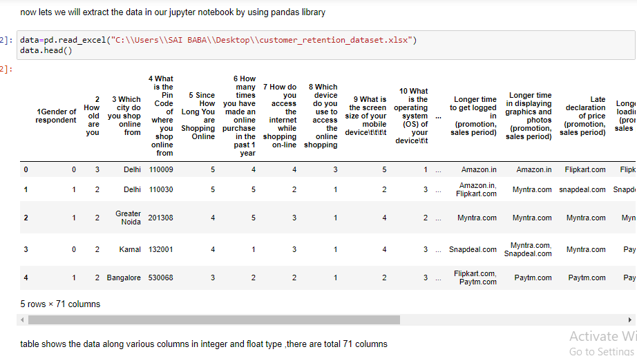
Step-2(extract the dataset in jupyter notebook)

Slide 5
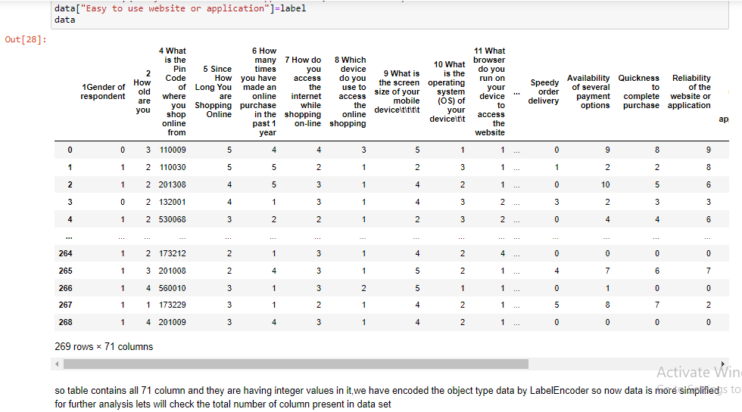
Step-3(Encoding the dataset)

Slide 6
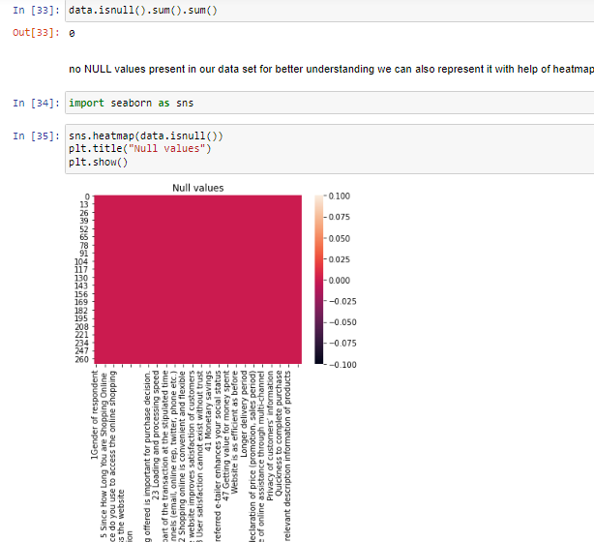
Step-4(checking null values)

Slide 7
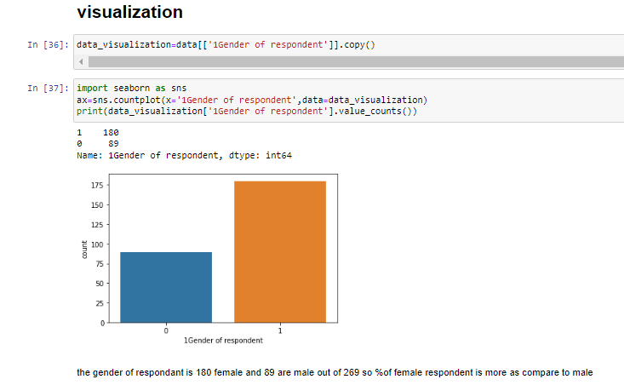
Step-5(visualization)

Slide 8
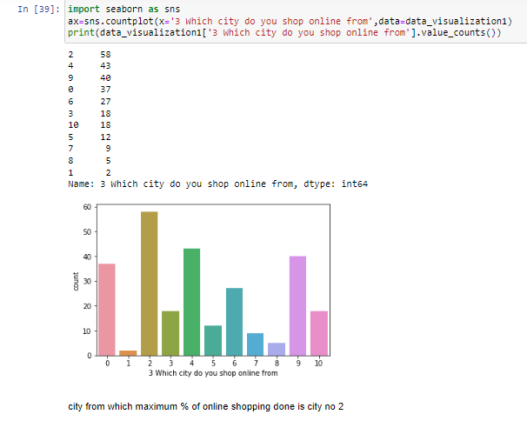

Slide 9
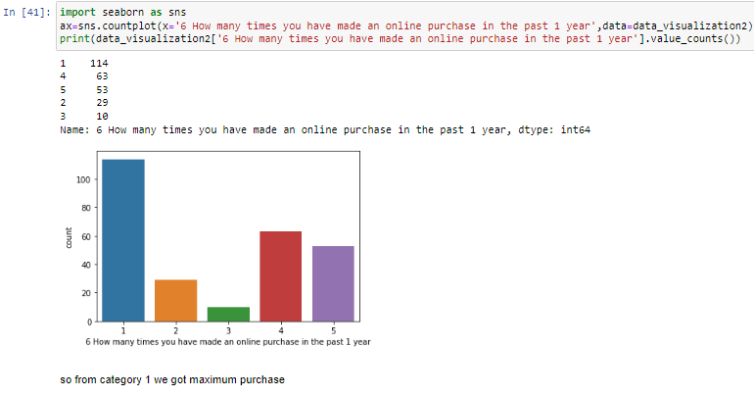

Slide 10
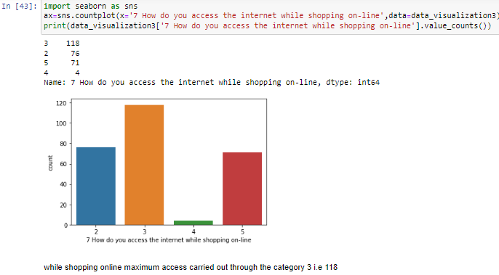

Slide 11
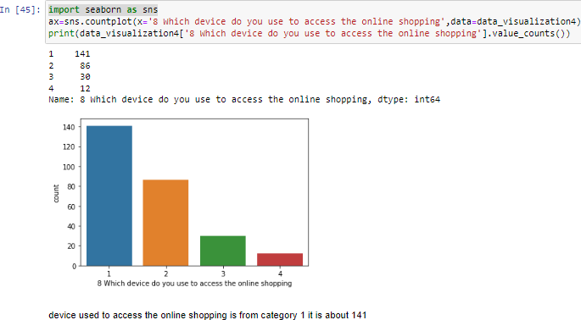

Slide 12
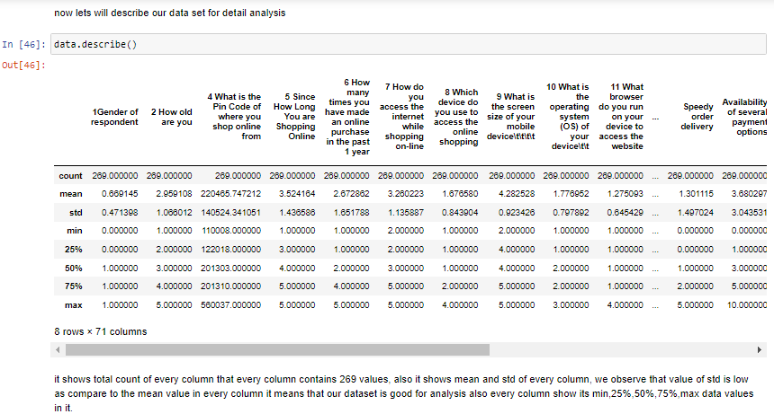
Data Description

Slide 13
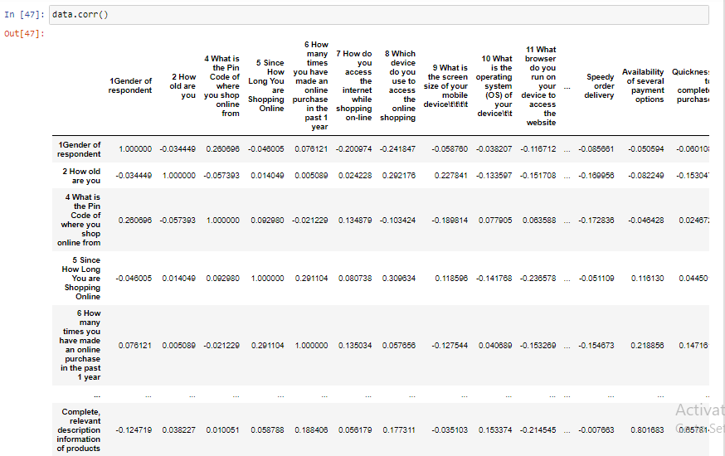
Data Correlation

Slide 14
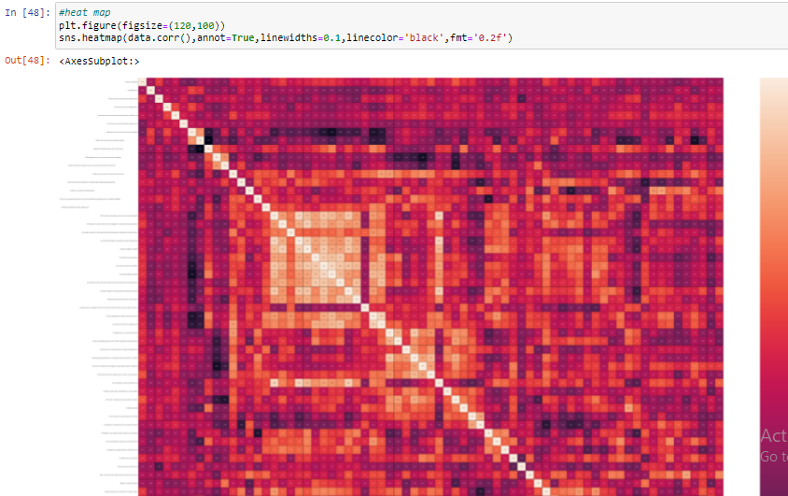
HEATMAP

Slide 15
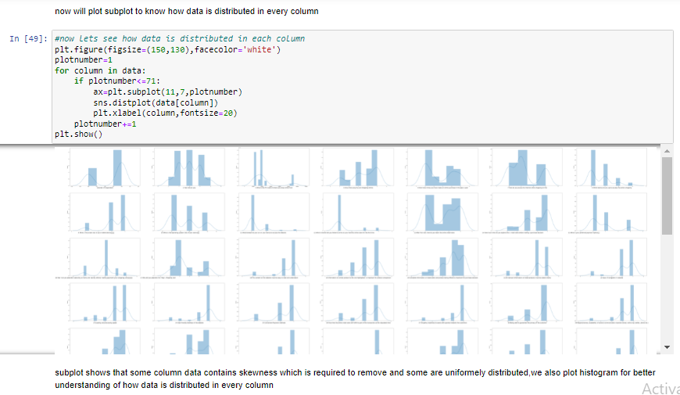
Data Distribution(subplot)

Slide 16
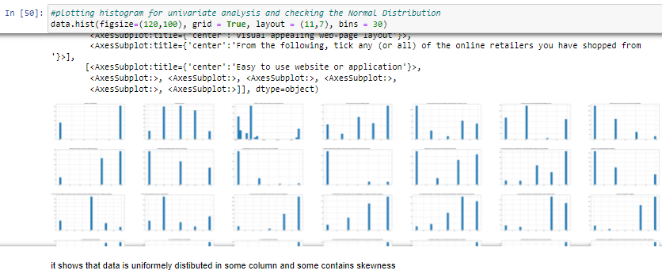
Data Distribution(Histogram)

Slide 17
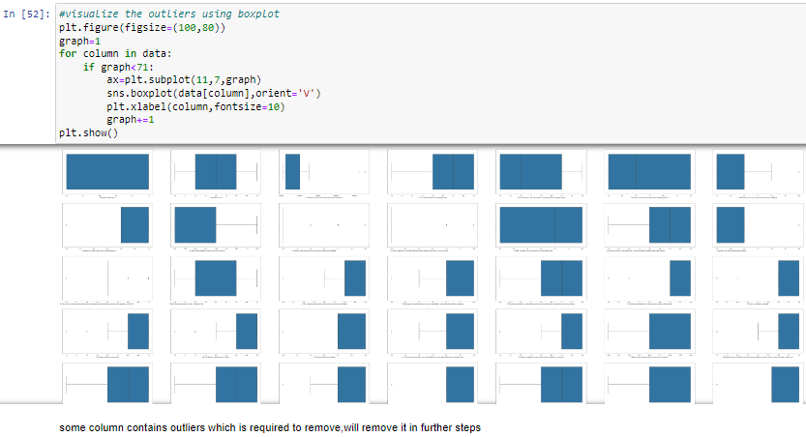
Outliers Detection

Slide 18
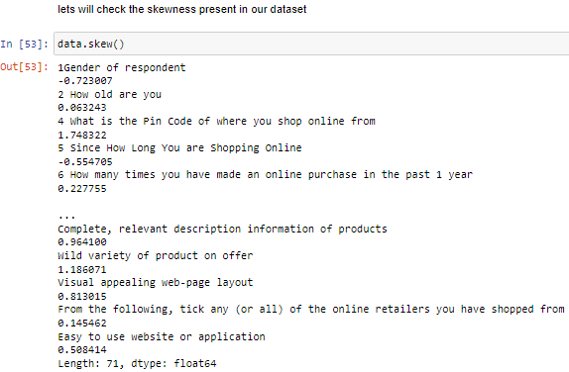
Checking Skewness

Slide 19
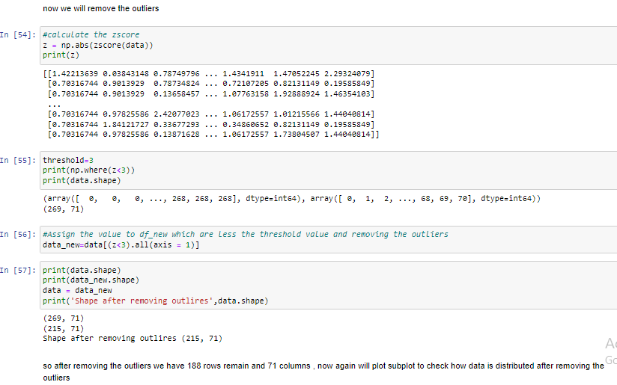
Removing outliers

Slide 20
Conclusion
it shows that now data is uniformly distributed in columns and we can use now this data to built machine learning algorithm for future prediction

